Slide 1
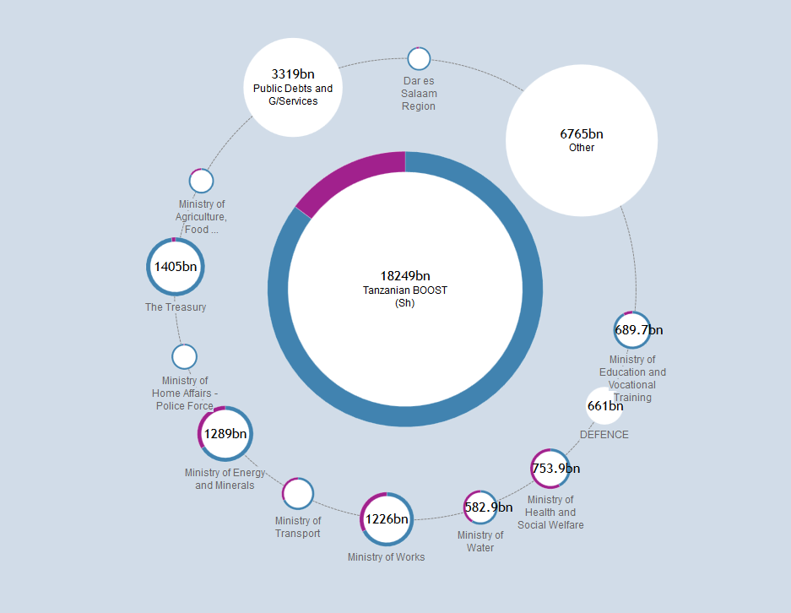

Aligning aid with partner country budgets
Progress update, January 2014

Slide 2
What is the budget identifier?
Economic classification
  capital v recurrent
Common code, or “Spine”
  match donor projects against partner country budget codes

Slide 3
Demand and need for budget ID
CABRI 2011 Position on Aid Transparency
2010 report – recommended common code
2012 report – successfully tested common code against 40 country budgets
  Both reports also recommended economic classification
2012 – Budget ID approved, subject to piloting
Notes:
Last big piece of the IATI Standard.
Link back to aid effectiveness:
alignment, harmonisation, ownership
CABRI – first point under useful information:
“Aid information is useful when it can be aligned with country budgets and supports country internal, legislative and social accountability processes. Therefore, countries require:
aid information (especially with regard to off-budget aid) to be classified consistently to align with the country categories and classifications used for budget allocation and accountability processes, irrespective of whether the classification is administrative, programmatic and/or economic”
Probably more work has gone into this component than any other.

Slide 4
Summary of progress
Piloting by donors in Canada, Sweden, UK
  Supported by Publish What You Fund and the International Budget Partnership
Engagement with Government of Tanzania
Visualisations
Notes:
GoT – both provided BOOST data, and committed to test the budget ID

Slide 5
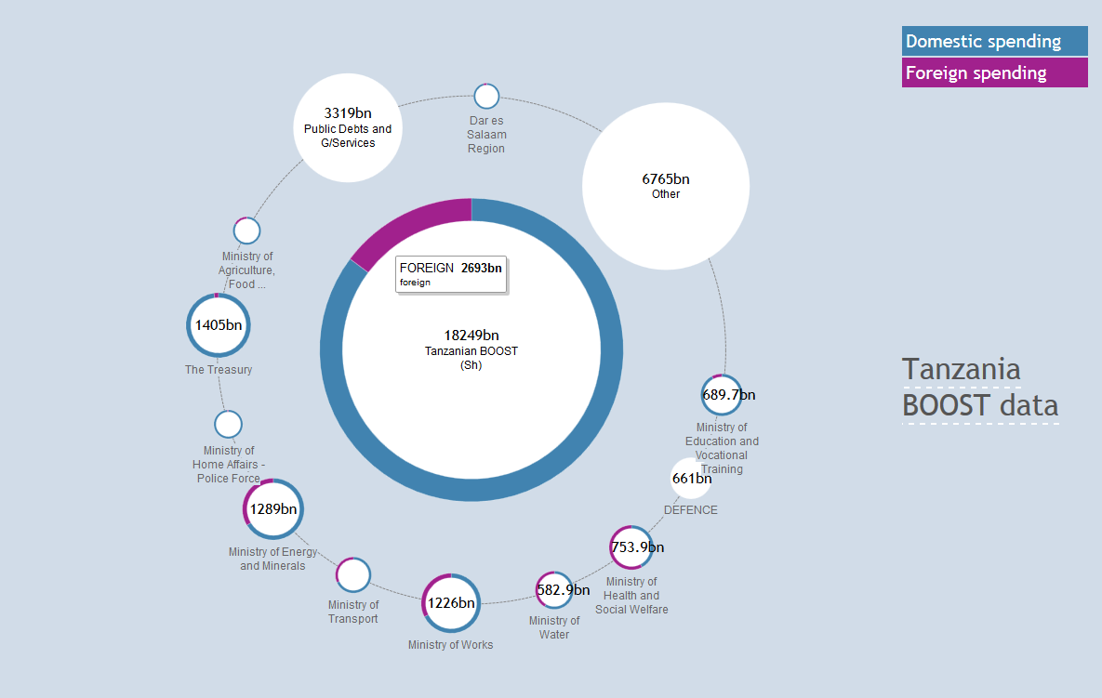
http://publishwhatyoufund.org/testarea/tz/
Notes:
High-quality BOOST budget shared by Tanzanian government – we can see how donor funding is distributed across each Ministry. BOOST is a great project and we are very supportive of it. However, in terms of donor funding:
This is only possible because people manually and laboriously coded up donor projects at country level
This doesn’t include off-budget flows – there are about 400 donor-funded projects in the budget, after accounting for duplication.

Slide 6
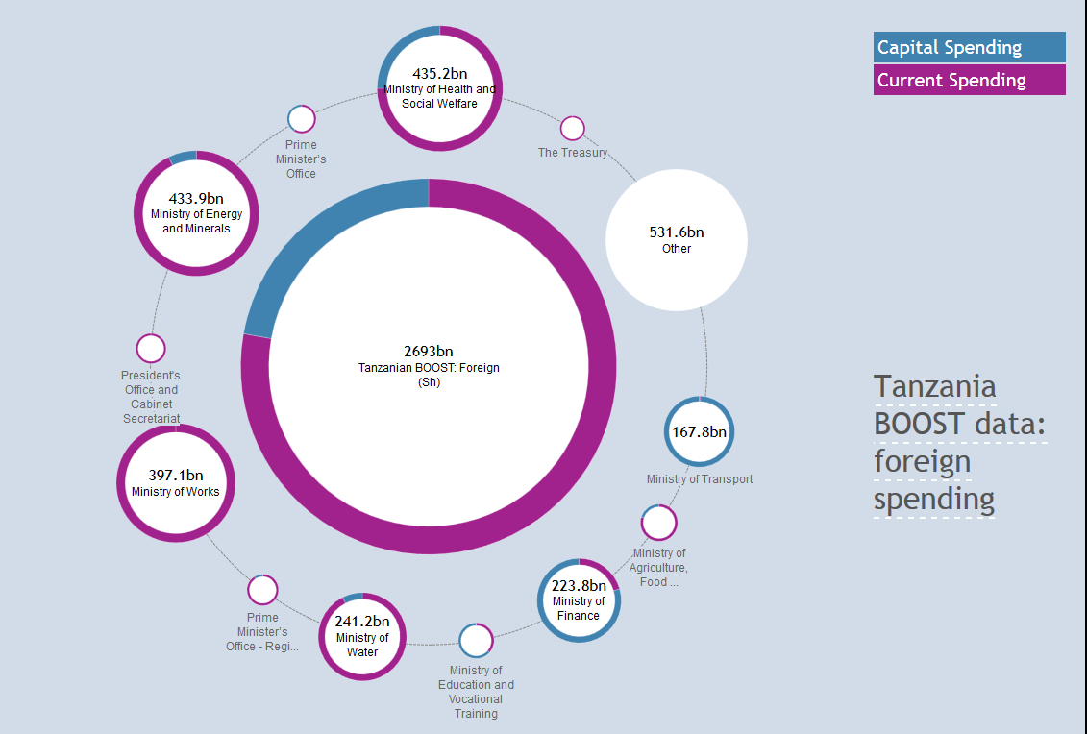
http://publishwhatyoufund.org/testarea/tz/foreign.htm
Notes:
We can also see how donor funding relates to economic classifications – capital and recurrent.
However, again this has to be manually and laboriously coded up at country level, and it’s still an incomplete picture.

Slide 7
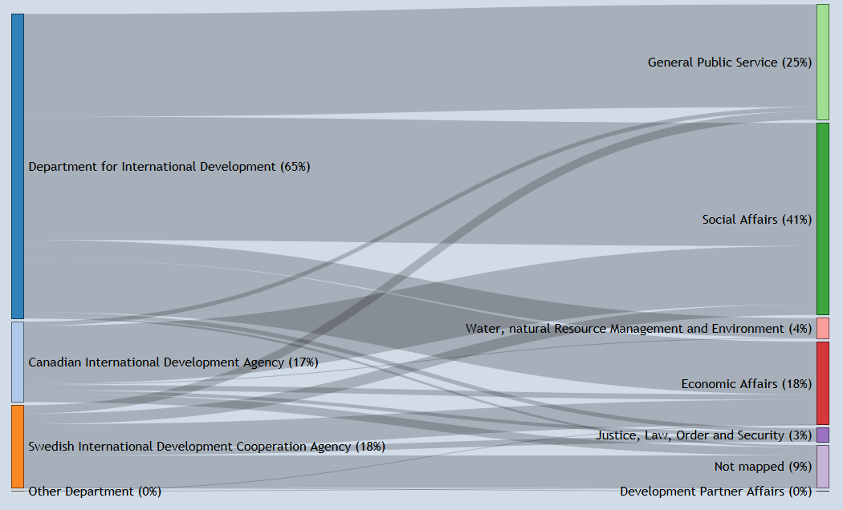
Mapping Donors’ CRS Sectors against the Common Code
http://publishwhatyoufund.org/testarea/tz/mapping/donors-category.html
Notes:
Can we map this data automatically to the “Spine” (and thereby, on to country budgets)?
The answer: to some extent, yes. Only 9% of projects (by volume) are unmapped.

Slide 8
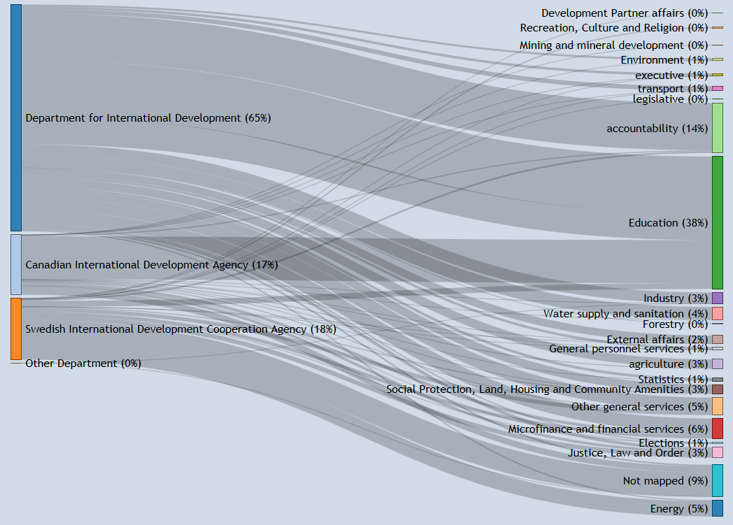
http://publishwhatyoufund.org/testarea/tz/mapping/donors-sector.html
Notes:
We can also see the same data at a more detailed level.

Slide 9
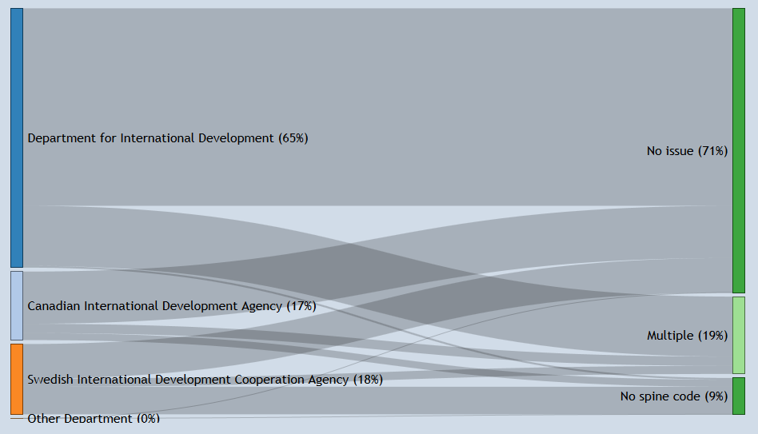
Automatic mapping: only partially successful
http://publishwhatyoufund.org/testarea/tz/mapping/donors-spine.html
Notes:
However, this is actually only partially successful.
Only 71% of projects by volume have a 1:1 match between a CRS sector code and a Spine code. 19% of projects map to multiple Spine codes and 9% map to no Spine code.
It’s a very similar story if we only look at project-based aid: then, the proportion with no issue increases to about 74%.
Mapping to multiple Spine codes (in some cases, 15 different codes for a single project) is problematic because it’s not clear exactly where the aid should be placed within the government’s budget – so it doesn’t really help.
Sweden coded up approx 93% of their funding, and have now published this in their IATI data
Canada and DFID both map about 75% of their projects

Slide 10
Conclusions on the common code
Automated mapping, using CRS codes:
  Using more than 1 CRS sector code helps (rather than, e.g. “Multisector aid”)
  Add “flags” to recommend additional validation
For the last 30%, more specific coding is needed
  For new projects, donors should consider scope to add additional fields to project management systems to identify common code(s)
Notes:
Publishing to IATI helps. We would be at 0% rather than 71% otherwise.
Find that 83% of projects with 2 CRS sectors can be mapped to specific Spine codes, compared to 68% of projects with only 1 CRS sector code.
30% - could be done retrospectively, but this proved impractical in this pilot – would probably have high cost.
Need to be aware of selection bias in donors.
The three donors are all publishing good quality data (with multiple sector codes, for example) and all worked to try and find different ways to generate this information. Other donors may not be publishing such good quality data in terms of sector codes, in which case the exercise would be much harder. Additionally, there are significant amounts of budget support from all three donors, which probably underemphasises the problem relative to other donors in the country (as well as non-official donors).

Slide 11
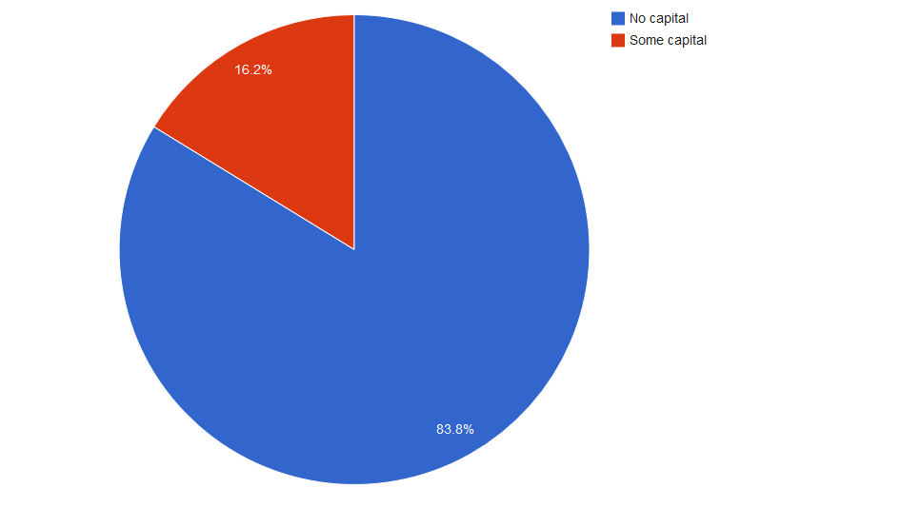
DFATD projects and economic classification
http://publishwhatyoufund.org/testarea/tz/mapping/dfatd-economic.html
Notes:
A significant proportion (25%) of aid spending in Tanzania is capital spend, according to the BOOST data previously shown.
In the case of Canada, we were able to identify one project (16.2% of the total) that may involve some capital spend.
Discussion around definitions – What constitutes capital expenditure? Perspectives important – looking for capital from perspective of partner country, not the relevant Ministry of Finance/Treasury in the donor country.

Slide 12
Conclusions on the economic classification
Need guidance to ensure consistent classification of capital expenditure
Not possible to generate economic classification from existing published data
Explored creative ways of generating this data from other internal data
Probably need to collect data at source
  potential systems developments may be needed by some donors
Notes:
There is no place in the IATI Standard where this information is currently captured.
e.g. the Canadian Environmental Assessment Act, which requires an assessment for any project involving construction.
Canada – CEAA appears to filter potential capital projects, to then manually identify.
Sweden – current systems unable to identify capital projects, so planning to update systems
UK – can identify capital spend from budget type code in project management system (ARIES)

Slide 13
Next steps and discussion
Report back to IATI Steering Committee
Discussion:
  what additional work is needed
  country-level case study of integration
    technical issues
    process issues
  understanding, use and quality of data at country level
  timelines
Notes:
(broader than just the budget identifier)

Slide 14
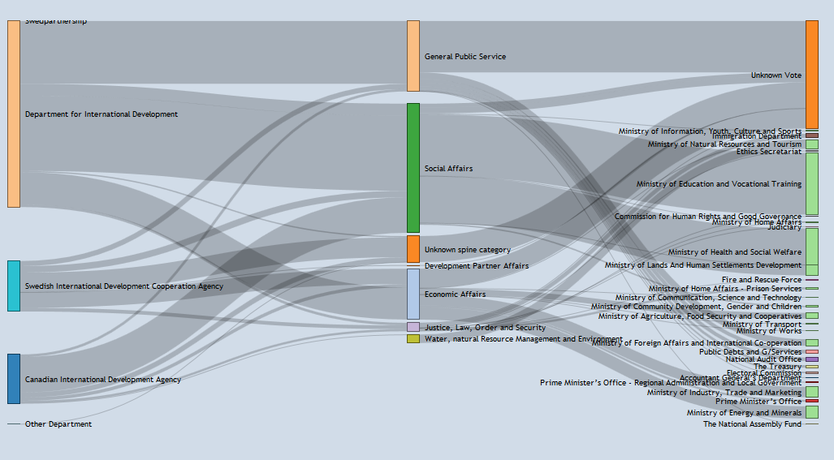
Mapping from donors, to the Spine, to the budget
http://publishwhatyoufund.org/testarea/tz/mapping/donor-spine-vote.html

