Slide 1

Transparency and U.S. Aid:
The what, the how and why now?
Sally Paxton,
Publish What You Fund U.S. Representative
www.publishwhatyoufund.org

Slide 2
What’s the issue?
Lack of reliable information
Difficult to make informed decisions
Affects all stakeholders

Slide 3
What’s the goal?
Information that is:
Timely
Comprehensive
Comparable
Accessible
Leads to decisions that allow for better:
Management
Donor coordination
Planning – both donors and recipients
Accountability

Slide 4
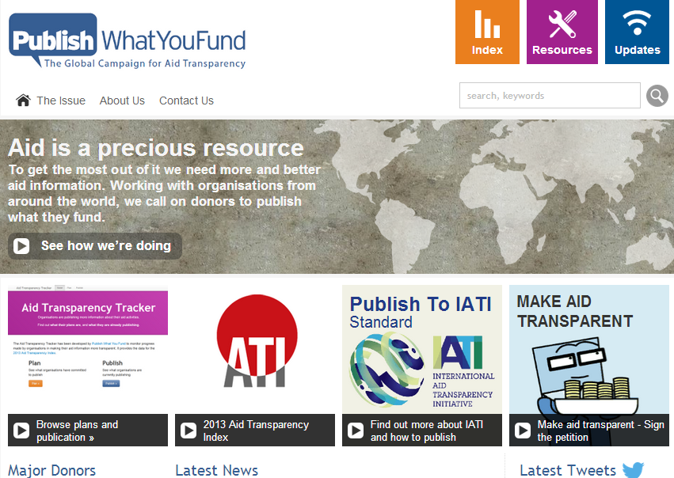

Slide 5
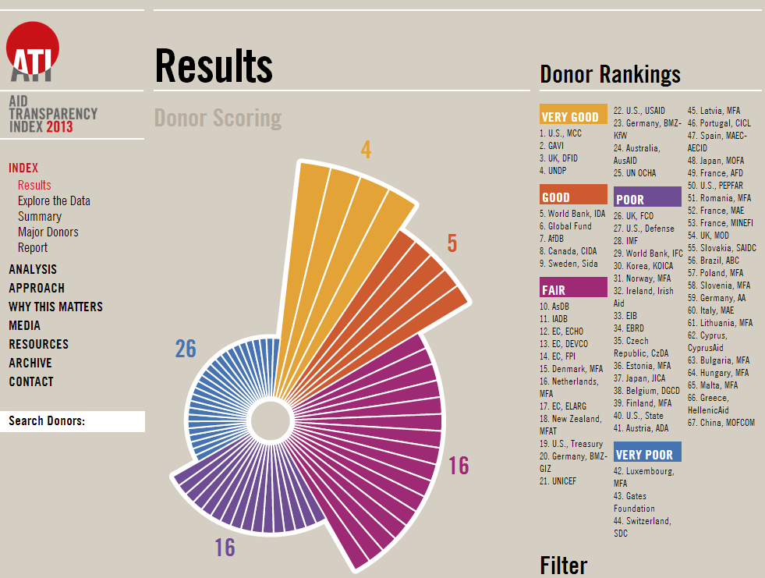

Slide 6


IATI STANDARD
IATI REGISTRY

Slide 7
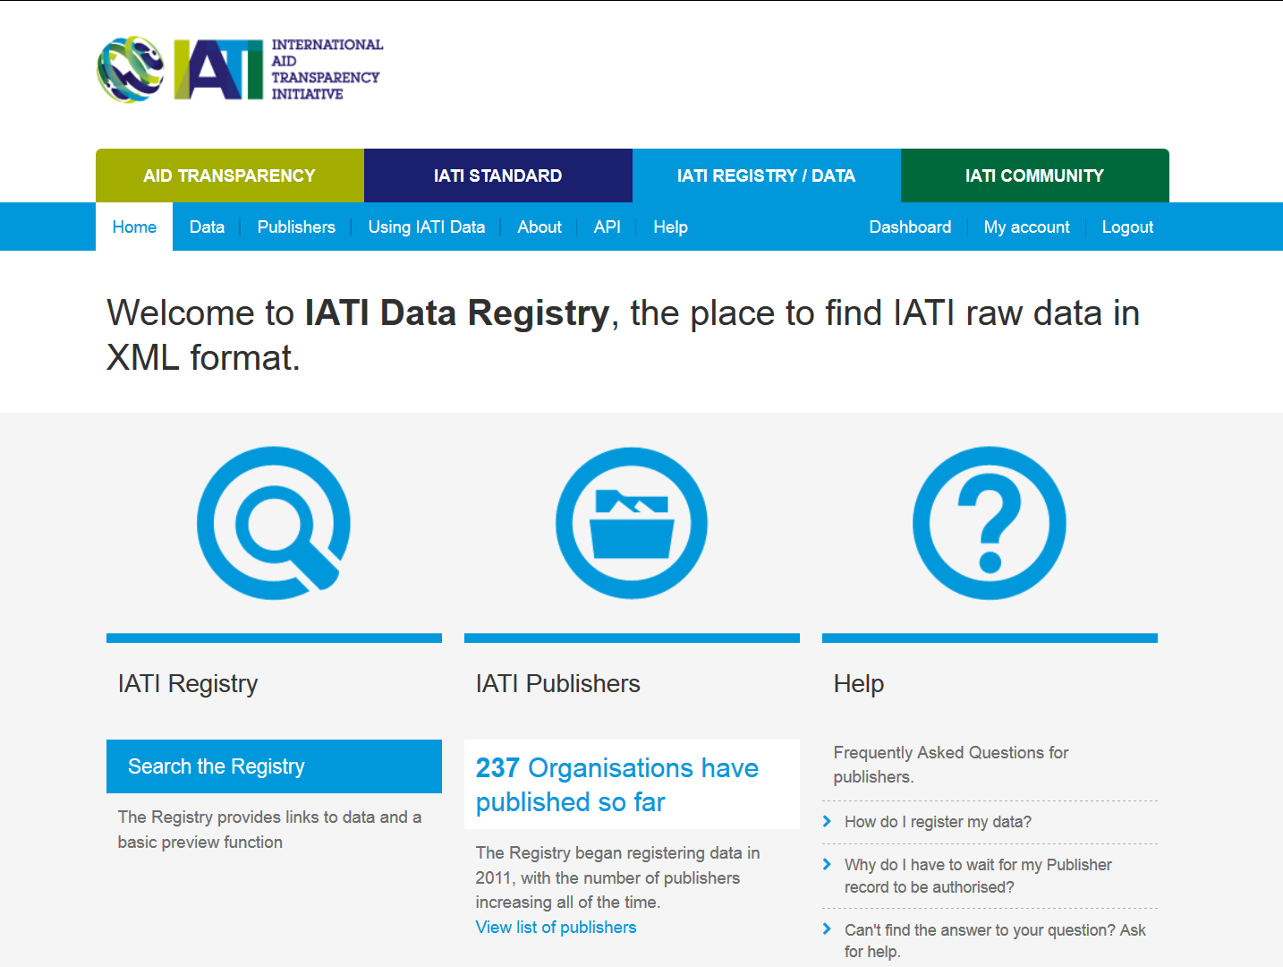

Slide 8
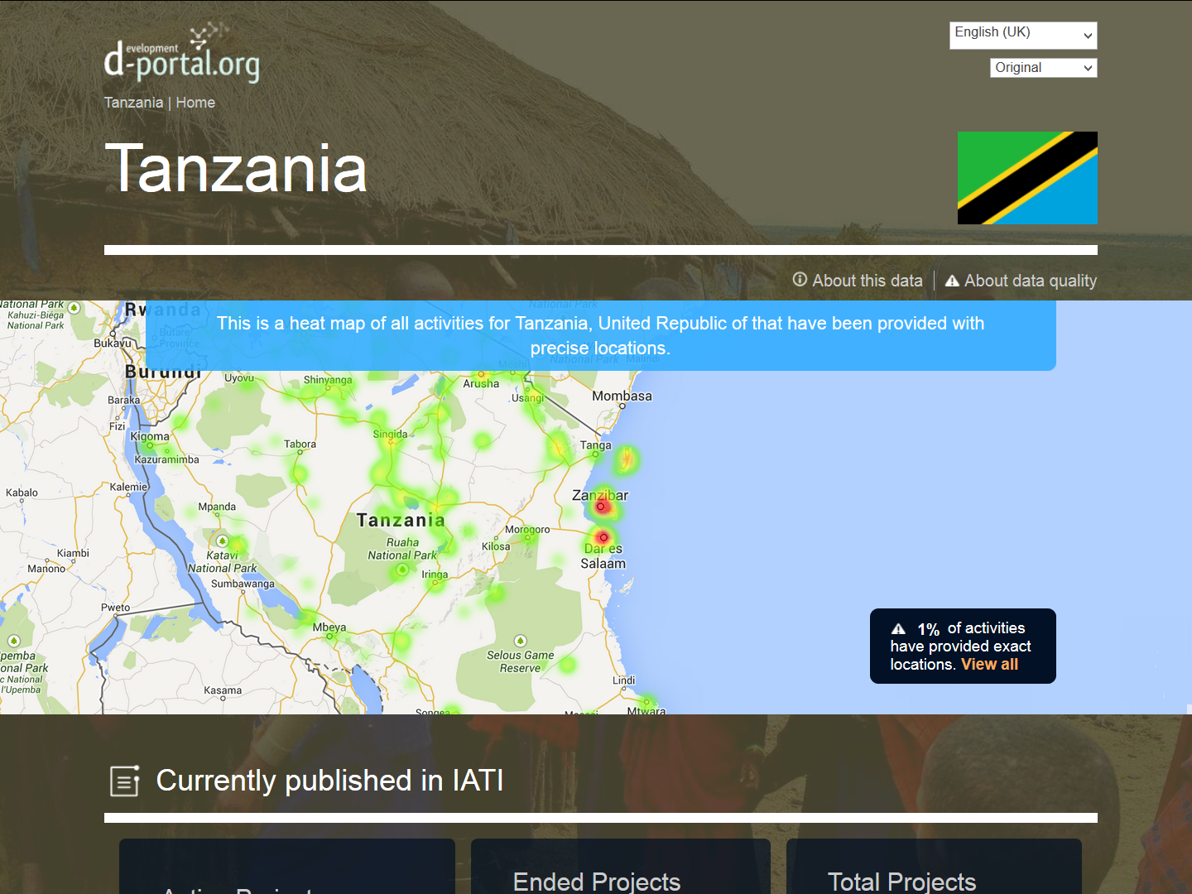

Slide 9
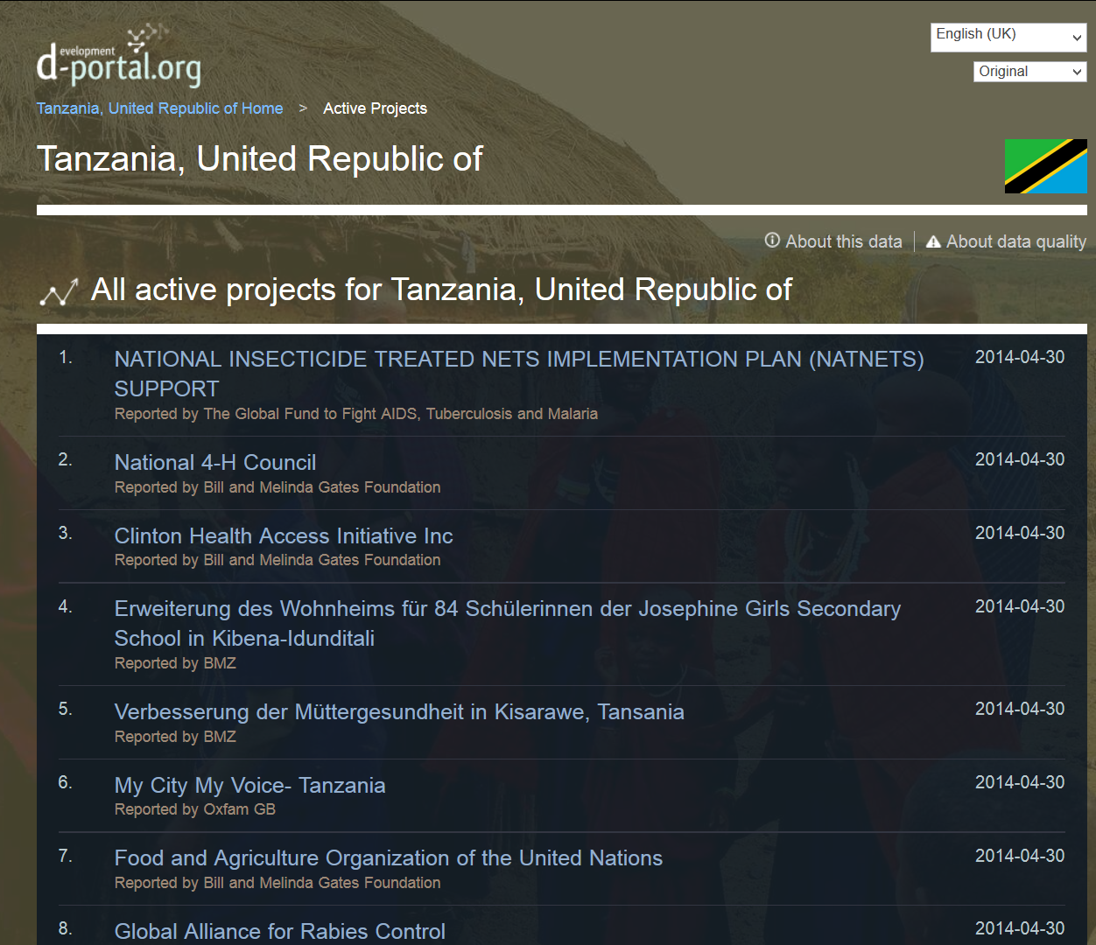

Slide 10
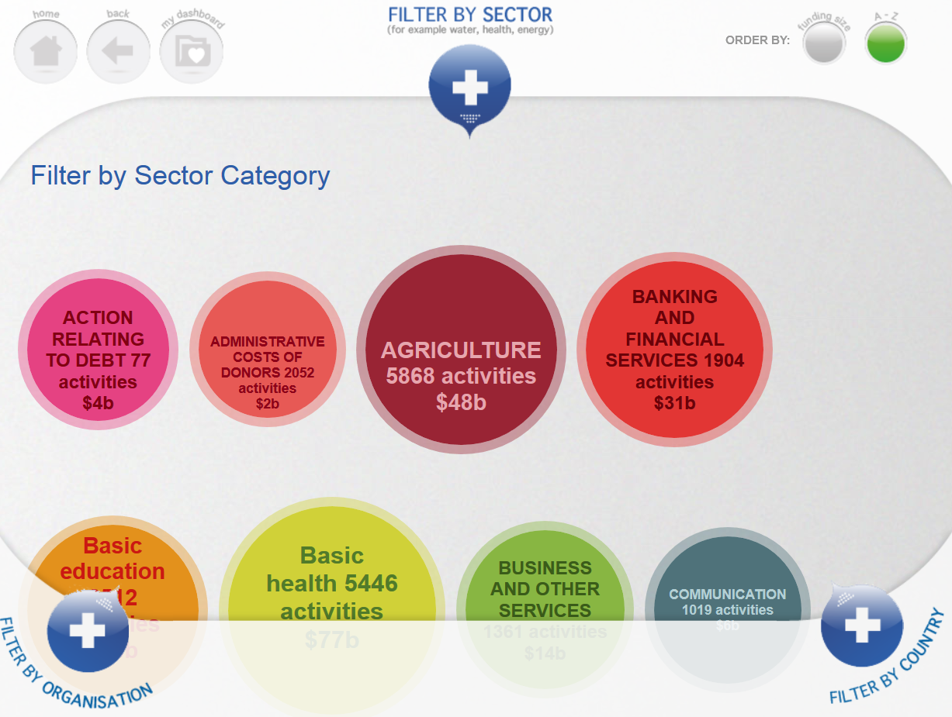

Slide 11
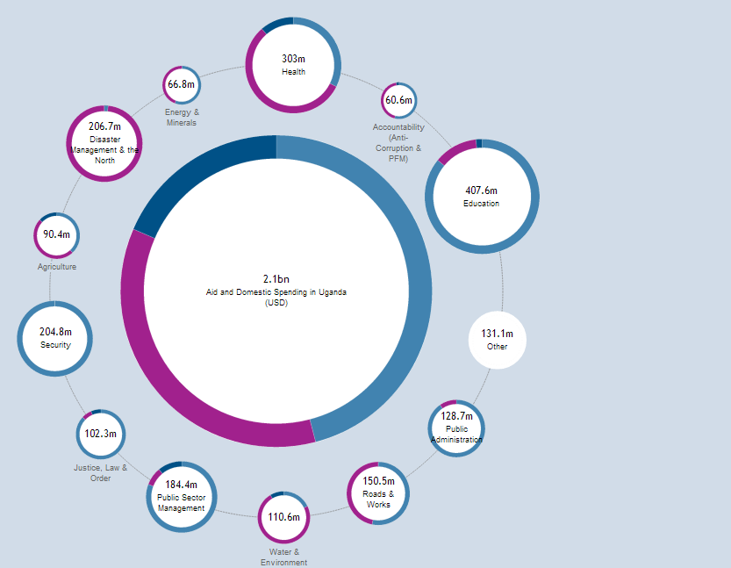





Slide 12
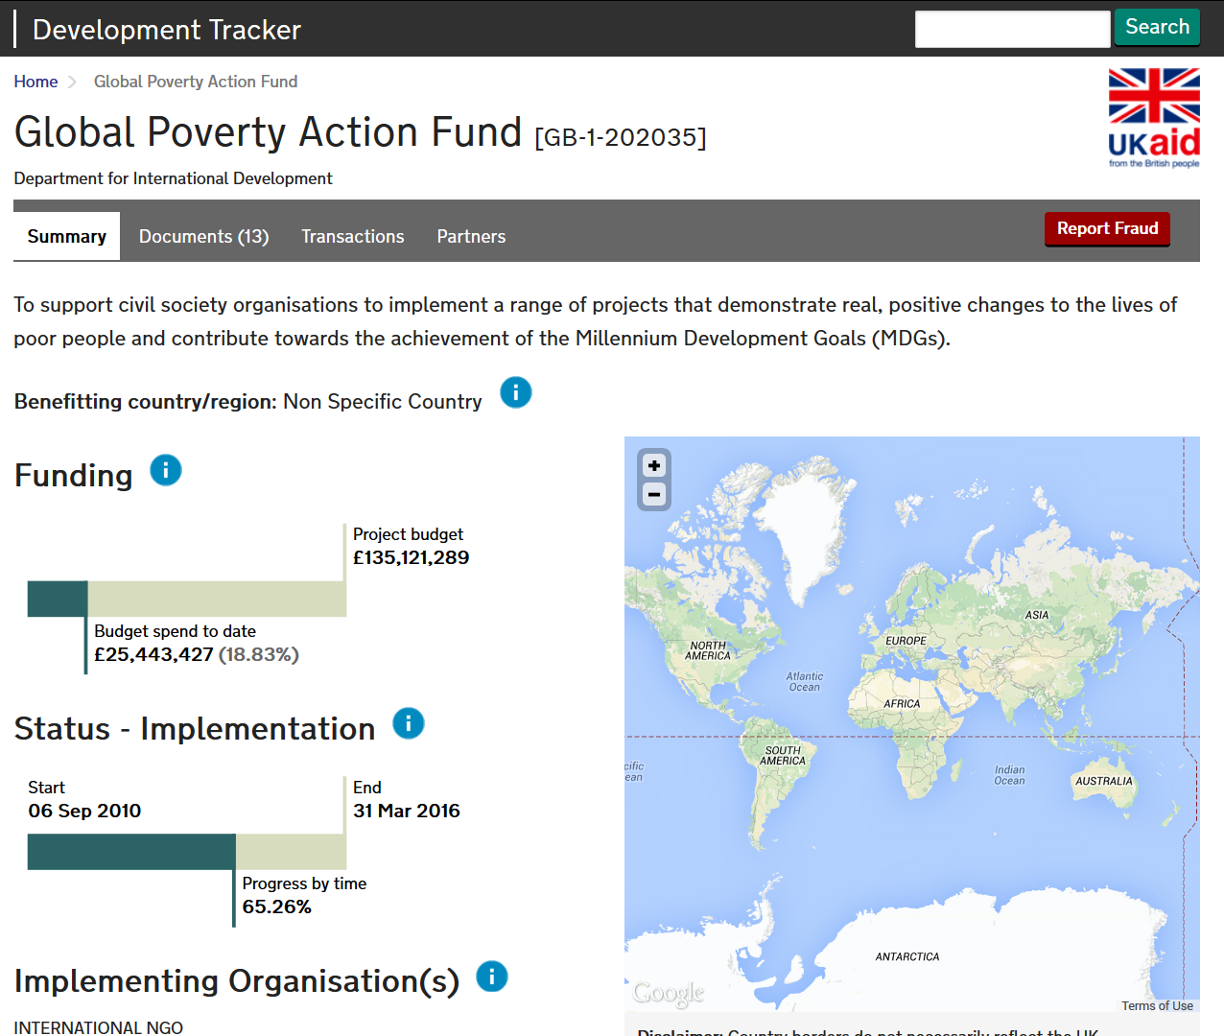

Slide 13
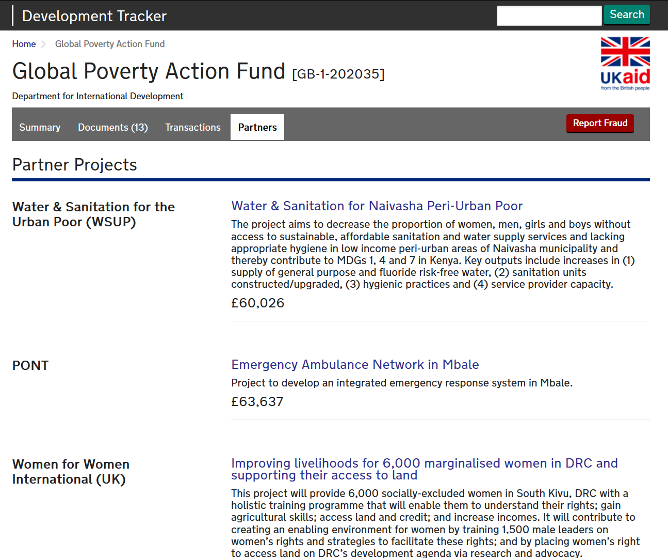

Slide 14
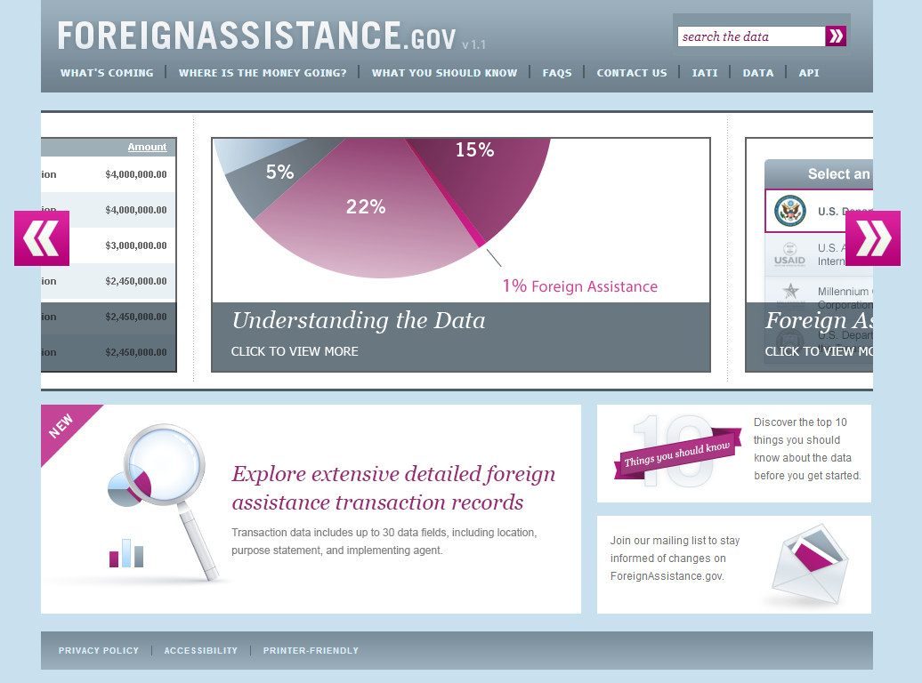

Slide 15
Conclusions:
Publish once and use often
  US IATI data can fulfill a multitude of obligations
There is a demand by a number of stakeholders
  Recipient governments, donor governments, NGOs and other users of aid data
The U.S. needs to accelerate progress to realize IATI potential
  Clock is ticking on 2015 commitment and US is behind
  It is in U.S. interests to produce high quality IATI data

