Slide 1

Aid Transparency Assessment 2010
Karin Christiansen
World Bank, 8th December 2010

Slide 2
Aims & Objectives
We know that aid is not always delivering the maximum impact possible
Aid transparency is fundamental to delivering on donors’ aspirations and the promise of aid
Essential to a series of aid effectiveness commitments
  Accra Agenda for Action specific aid transparency commitments as well as Paris Dec & upcoming HLF4
Our attempt to undertake a comparative stock take of the current levels of aid transparency
Notes:
Commitments made as part of 2003 Rome Declaration and particularly 2005 Paris Declaration.
Recognition that donors were struggling to deliver on those commitments. Accra Agenda for Action and launching of IATI.

Slide 3
The Publish What You Fund Aid Transparency Principles
Information on aid should be published proactively
Information on aid should be comprehensive, timely, accessible and comparable
Everyone can request and receive information on aid processes
The right of access to information about aid should be promoted
Notes:
Wanted to assess levels of publication for the full range of information types in terms of their comprehensiveness, timeliness and comparability – assessing donors on the first and second Aid Transparency Principles.

Slide 4
Approach & Methodology
Aim to assess levels of publication for the full range of information types in terms of their comprehensiveness, timeliness and comparability
But methodology was driven by lack of primary data available
Peer review committee established to advise on approach and methodology

Slide 5
Methodology
7 indicators in 3 categories
8 data sources (from 2006 to 2010)
3 categories given equal weighting
30 donors - because we could get data on them

Slide 6
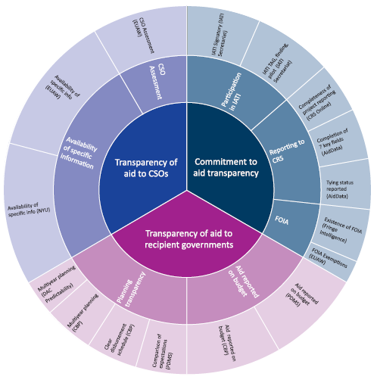
Indicators & data sources
Notes:
Use the limited data that exists to compare the transparency of 30 major donors across 7 weighted indicators that fall into 3 categories – high level commitment to transparency; transparency to recipient government; and transparency to civil society.
Data sources used most regularly are the DAC Creditor Reporting System; the Paris Declaration Monitoring Survey; the HIPC Capacity Building Project; the DAC Predictability Survey; the EU AidWatch 2010 survey; and information from the IATI Secretariat on participation in IATI.
Full details of data sources used included in Annex 1.

Slide 7
The Donors
Bilaterals: Australia, Austria, Belgium, Canada, Denmark, Finland, France, Germany, Ireland, Italy, Japan, Korea, Luxembourg, Netherlands, New Zealand, Norway, Portugal, Spain, Sweden, Switzerland, UK, U.S.
Multilaterals: African Development Bank, Asian Development Bank, Inter-American Development Bank, World Bank, United Nations
Other agencies: European Commission, GAVI Alliance, the Global Fund to Fight AIDS, Tuberculosis and Malaria (“Global Fund”)

Slide 10
Findings
Finding 1: There is a lack of comparable and primary data
Finding 2: There is wide variation in levels of donor transparency, across different types of donors
Finding 3: There are significant weaknesses across indicators
Notes:
Finding 1: There is currently no systematic, disaggregated way of assessing the transparency of donors.
Finding 2: Donor scores varied widely. Large and small donors, multilaterals and bilaterals appear throughout the ranking. The average score across all donors is 60.8%.
Finding 3: There is significant variation in performance across the indicators we assess:
Category 1: Commitment to Aid Transparency, average score 66.5%
Category 2: Transparency of Aid to Recipient Governments, average score 54.9%
Category 3: Transparency of Aid to Civil Society, average score 60.9%

Slide 11
Finding 1:
There is a lack of comparable and primary data

Slide 12
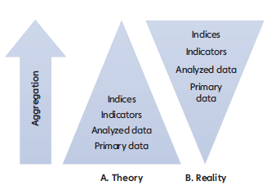

Slide 13
Finding 2:
There is wide variation in levels of donor transparency, across different types of donors

Slide 16
Finding 3:
Significant weaknesses across indicators

Slide 17
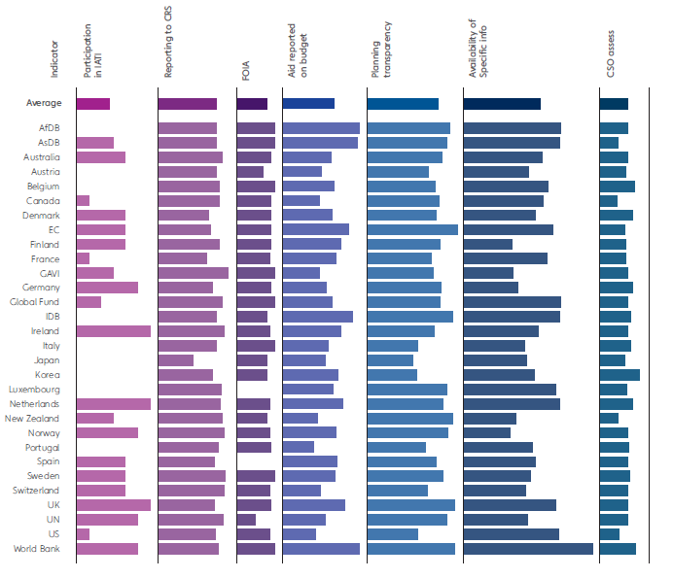

Slide 18
Conclusions
Conclusion 1: The lack of primary data means that it is not currently possible to assess donor aid transparency in the degree of detail desirable
Conclusion 2: Even so, we know enough to be confident that there is room for improvement across all indicators assessed
Notes:
Not possible to systematically assess all aspects of donor aid transparency at recipient country level. Paucity of comparable country-by-country, programme-by-programme data.
We use the best available information to compare some donors on some elements of aid transparency
Variation within donors are not captured. Would like to work with others to build a more ‘optimal’ assessment that addresses some of these concerns.

Slide 19
Recommendations
Recommendation 1: Donors have demonstrated they can make information available, so they should
Recommendation 2: Transform more information into better information through a common standard – mappable, searchable, useable
Recommendation 3: Ensure common standard delivers for everyone – recipient systems esp. budgets, donors internal systems, HLF 4
Notes:
A common standard is essential for transforming more information into better information – mappable, useable and searchable.
Underlying principle is that it allows aid agencies to publish once, use many times – both themselves and for other stakeholders.

Slide 20
Future aid transparency assessments
Future assessments would ideally cover greater range of aid agencies (e.g. all donor govts incl. ‘emerging’ donors, humanitarian agencies, INGOs, private companies, contractors)
Disaggregate donor performance country by country, programme by programme – variation inside agencies
Cover range of info types from aid policies/ procedures; aid strategies; aid flows; terms of aid; procurement; assessments of aid & aid effectiveness; integrity procedures; public participation; to access to info mechanism
BUT need your help and suggestions on way forward
Notes:
We want to discover variation in transparency within agency, whether they are equally transparent, and about their aid to, for example, Afghanistan, Liberia or Uganda.

Slide 21
Thank you & Feedback
For more information: http://www.publishwhatyoufund.org/resources/assessment/visualise/
Our contacts:
Catalina.Reyes@PublishWhatYouFund.org
Karin.Christiansen@PublishWhatYouFund.org

Slide 22
Additional information and methodology

Slide 23
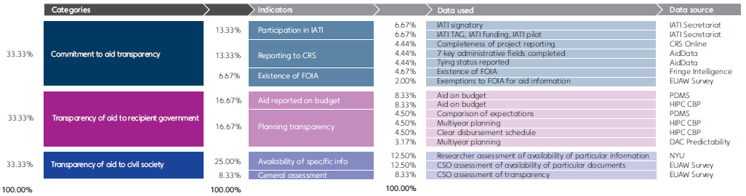
Weightings
Notes:
Additional slide if asked about weightings
We have weighted indicators on the basis that we have large amounts of data for some aspects of transparency and limited amounts for other aspects.
To weight each data source equally would promote some aspects at the cost of others.
Weighting of indicators reflects that transparency is important for different types of information users.

Slide 24
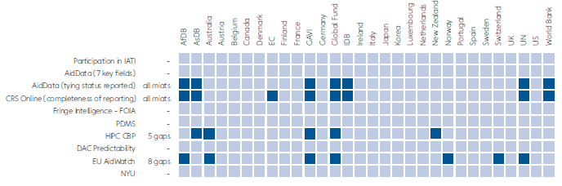
Data gaps

Slide 25
Reviewers & data assistance
Nancy Birdsall, David Roodman, Ayah Mahgoub and Rita Perakis at CDG
Helen Darbishire, Access Info Europe
Jörg Faust, German Development Institute
Nathaniel Heller, Global Integrity
Homi Kharas & Daniel Kaufmann, Brookings Institution
Richard Manning, Chair of IDS and former Chair of the OECD DAC
Vivek Ramkumar & Elena Mondo, International Budget Partnership, Center on Budget & Policy Priorities
Judith Randel & Rob Tew, Development Initiatives
Claudia Williamson, New York University
Assisted with data: Yasmin Ahmad and Robin Ogilvy, OECD DAC; Alessandro Bozzini, EU AidWatch; Stephen Davenport, Development Gateway Foundation and AidData; Romilly Greenhill, Brian Hammond and all at the IATI Secretariat; Matthew Martin, Development Finance International; Brooke Russell, AidData; Philip Tamminga, DARA International; Roger Vleugels, Fringe Intelligence; Claudia Williamson and William Easterly, New York University

Slide 26
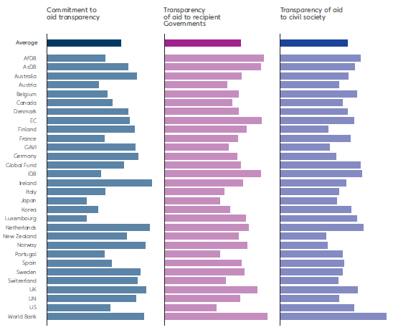
Performance across the three categories
Notes:
Table shows donor performance across all three categories. Average score is shown at the top.

Slide 27
Our Paris Indicator Methodology

Slide 28
What donors schedule for disbursement in year n
What donors actually disburse in year n
PDMS Indicator 7
What recipients expect to receive in year n
What recipients record in their budgets for year n

Slide 29
What donors schedule for disbursement in year n
What donors actually disburse for govt sector in year n
PDMS Indicator 3
Recipients budget estimates of aid flows in year n
What recipients record in their budgets for year n

Slide 30
What donors schedule for disbursement in year n
What donors actually disburse for govt sector in year n
Compare expectations
Aid on budget
Recipients budget estimates of aid flows in year n
What recipients record in their budgets for year n

